Slide 1
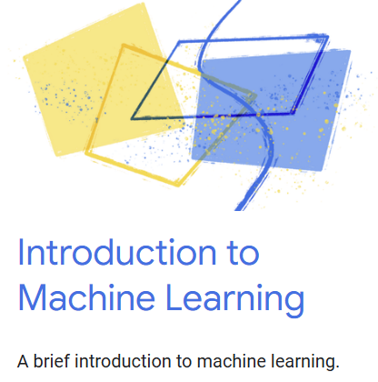

Google Machine Learning courses
Notes:
https://developers.google.com/machine-learning/intro-to-ml/

Slide 2
What you will learn
What is Machine Learning?
Focus on Supervised Learning

Slide 3
What is machine learning?

Slide 4
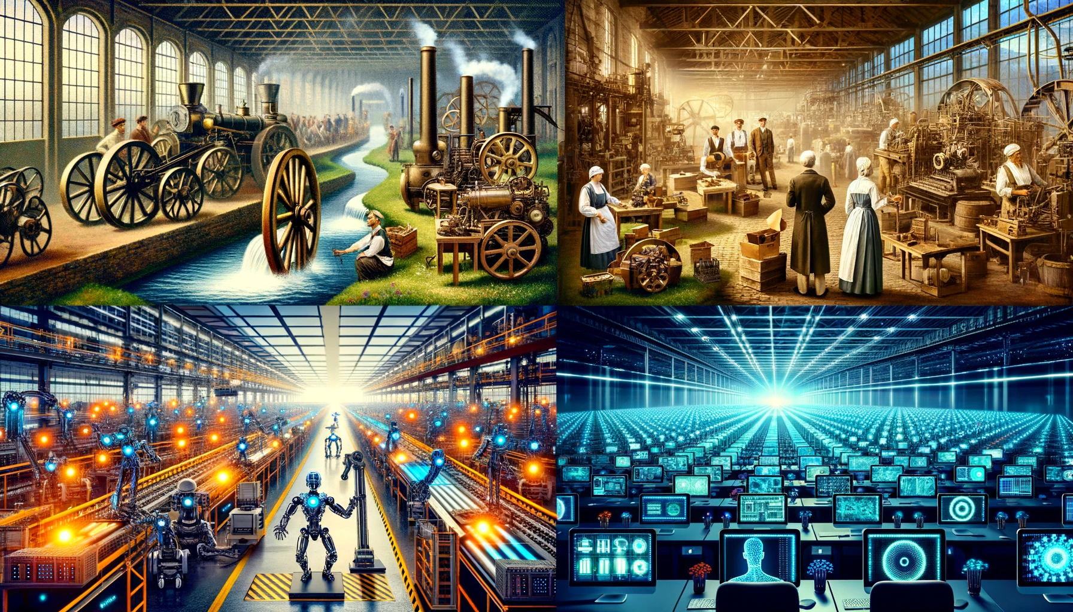
1.0 Mechanization, Steam, and Water Power
2.0 Mass Production and Electricity
3.0 Electronic / IT Systems and Automation
4.0 Cyber Physical Systems and
Artificial Intelligence
Notes:
https://www.forbes.com/sites/forbescoachescouncil/2023/10/30/generative-agile-leadership-what-the-fourth-industrial-revolution-needs/

Slide 5
What is Artificial intelligence?
Artificial Intelligence, or AI, is technology that allows machines to learn from information and act like humans, doing things like making decisions and understanding speech without needing step-by-step instructions.

Slide 6
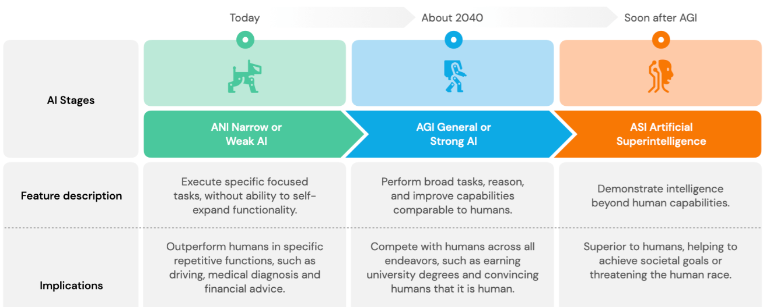
You Are Here
Notes:
https://hislide.io/product/3-type-of-artificial-intelligence-levels/

Slide 7
Originated in the mid-1950’s
Blanket term for all intelligent computing
Goal is to simulate human intelligence
Early forms of this were simple If…Then statements
Medical: Use a set of rules to determine diagnosis
Artificial Intelligence (AI)
Machine Learning (ML)
Deep Learning (DL)
Originated in the 1960’s
Goal is to get machines to learn from and make decisions based on data without a lot of rules
Machines learn through data patterns to solve problems
Weather: Uses machine learning to take in weather data and make a prediction about future weather
Originated in the 1980’s
Goal is to learn from lots of sample data so it can recognize pictures, words, or sounds by itself
Phone: Facial recognition on your phone uses deep learning to recognize you

Slide 8
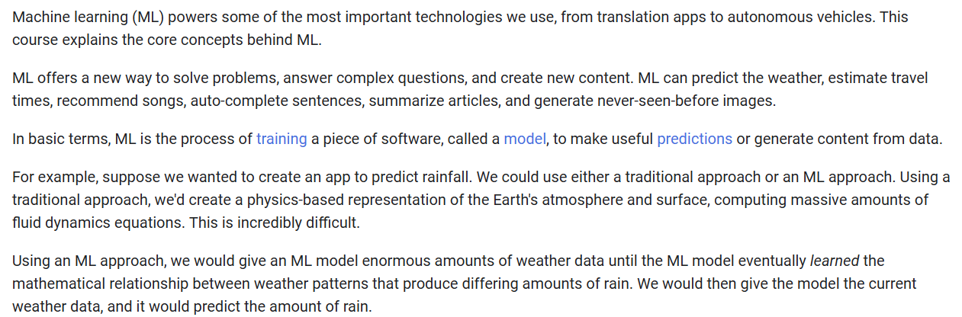
What is Machine Learning?

Slide 9




Notes:
https://www.youtube.com/channel/UC35ZpwldGw7ZJ5R-2sLijzw

Slide 10
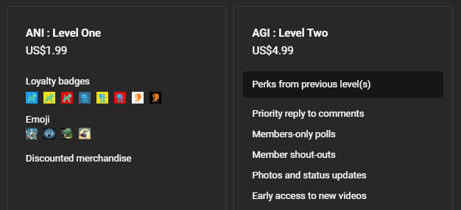
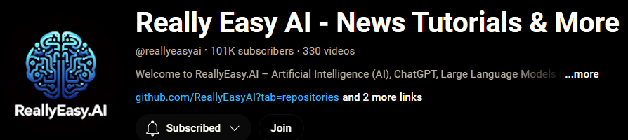
Membership has its privileges
Notes:
https://www.youtube.com/channel/UC35ZpwldGw7ZJ5R-2sLijzw/join

Slide 11

https://www.youtube.com/@AINewsFresh

Slide 12

https://www.youtube.com/@DailyAINewsPodcast

Slide 13

https://www.youtube.com/@AIPapersPodcastDaily

Slide 14
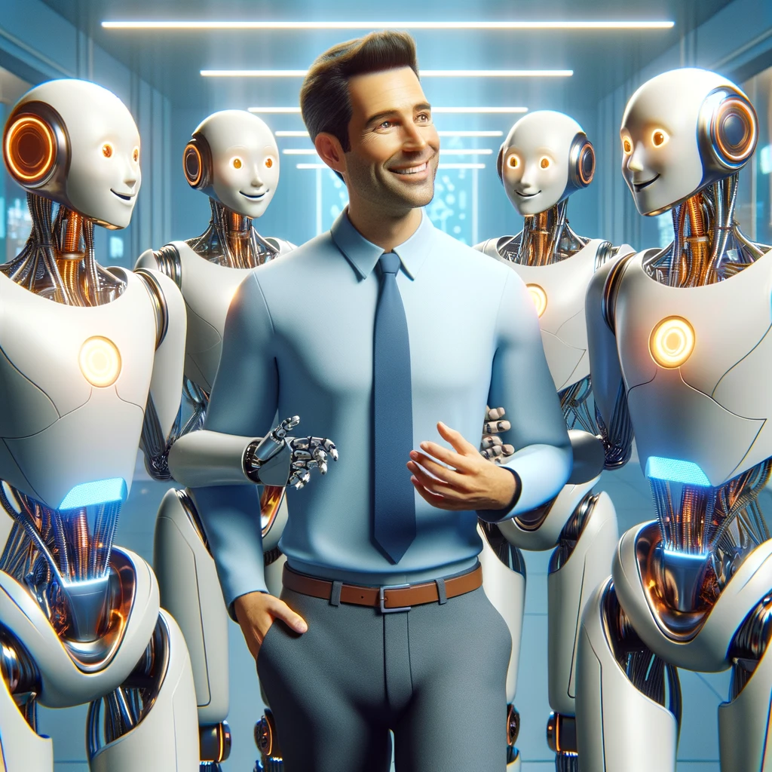
It’s all around you

Slide 15
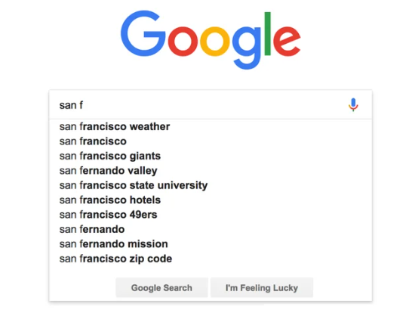

Slide 16

ML: Prediction
When you start typing a search term into Google, it uses a type of AI to predict what you might be looking for based on the first few letters you type. This AI looks at what lots of other people have searched for that starts with the same letters and suggests the most common searches to you. This helps you find what you need faster, even if you're not sure how to spell it or exactly what to search for.

Slide 17
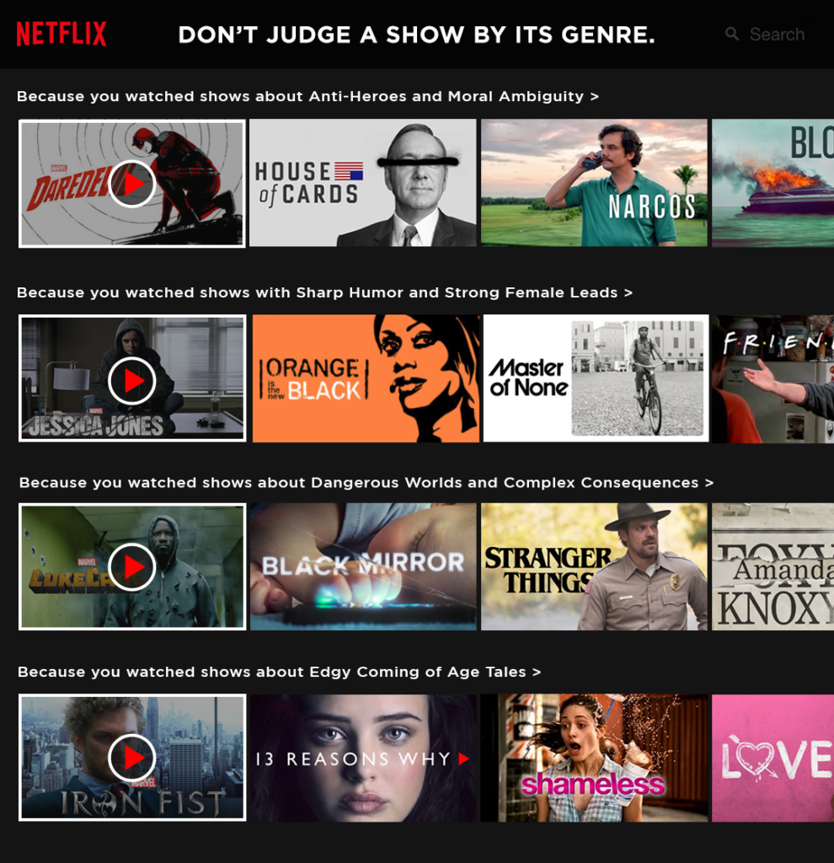

Slide 18

ML: Prediction
Netflix uses AI to figure out what kinds of shows and movies you like to watch. It looks at your previous choices, what you've watched and enjoyed, and then suggests other shows and movies that are similar. This way, the more you watch, the better Netflix gets at recommending things you might like.

Slide 19
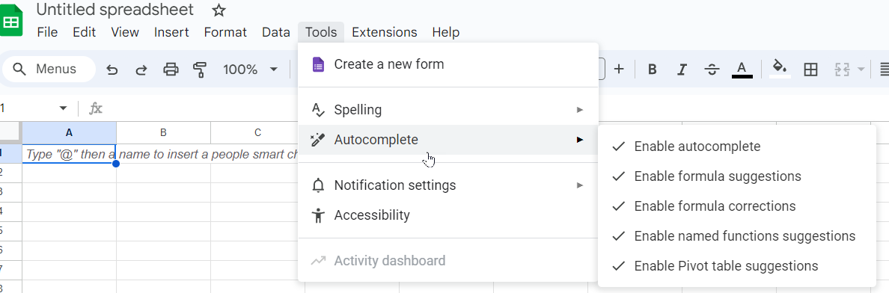

Slide 20
ML: Prediction
In Google Sheets, the autocomplete feature is designed to enhance your efficiency by predicting and suggesting text based on the content you start entering in a cell. When you type "@" followed by characters, Google Sheets begins to suggest relevant content, such as names of people or items that have been mentioned or used in your spreadsheet or connected Google services. This feature is part of Google’s smart fill capabilities, which use a form of AI to recognize patterns or common entries. It not only speeds up data entry but also helps reduce errors by suggesting accurate completions based on existing information. This is especially useful in large data sets or when you are collaborating with others, as it ensures consistency in the data entered.

Slide 21
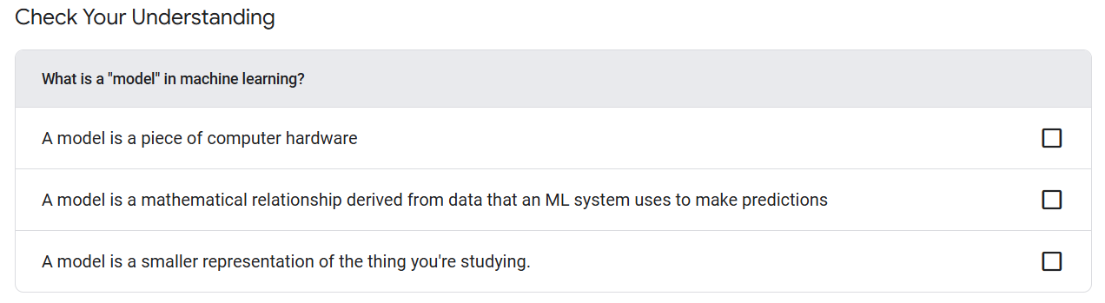

Slide 22
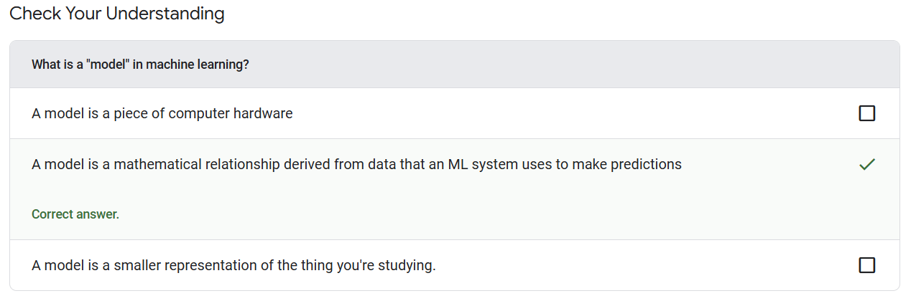

Slide 23
Model
A model is a computer program that has been trained on a large amount of data to perform a specific task, such as recognizing images, translating languages, or making predictions, without being explicitly programmed with rules for that task.

Slide 24
Types of Machine Learning

Slide 25
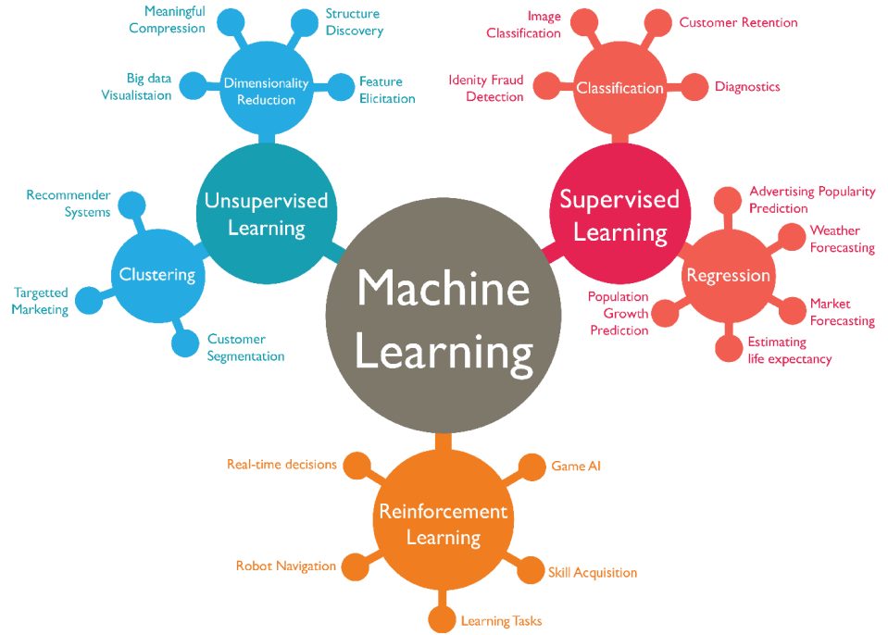
Notes:
https://medium.com/nerd-for-tech/dive-deep-into-machine-learning-66a39ce053b9

Slide 26
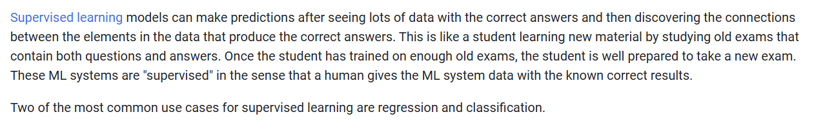
Supervised learning

Slide 27
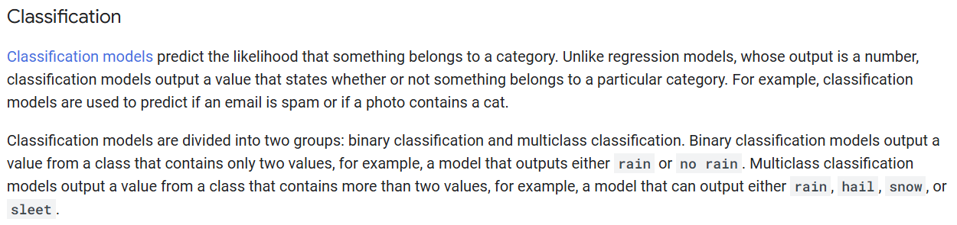

Slide 28
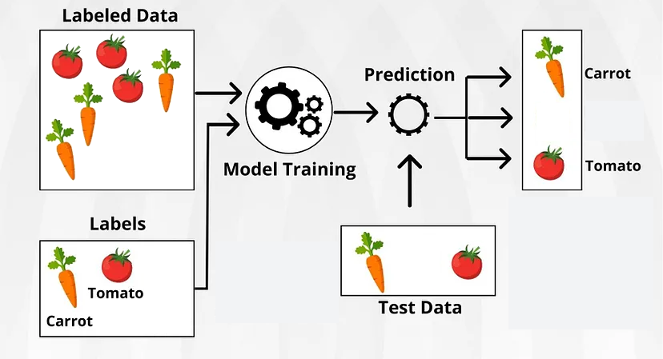
Binary classification
Notes:
https://medium.com/@gerzson.boros/a-simple-introduction-into-supervised-learning-dcce83ee3ada

Slide 29
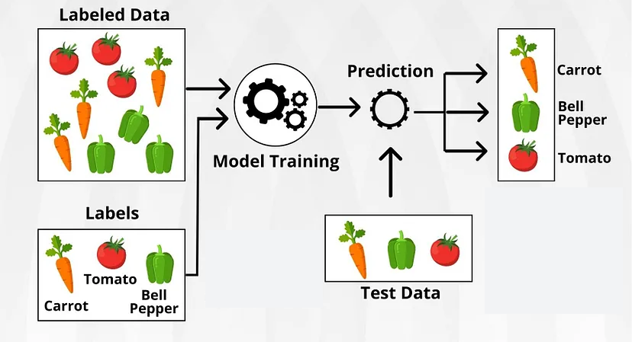
Multiclass classification
Notes:
https://medium.com/@gerzson.boros/a-simple-introduction-into-supervised-learning-dcce83ee3ada

Slide 30
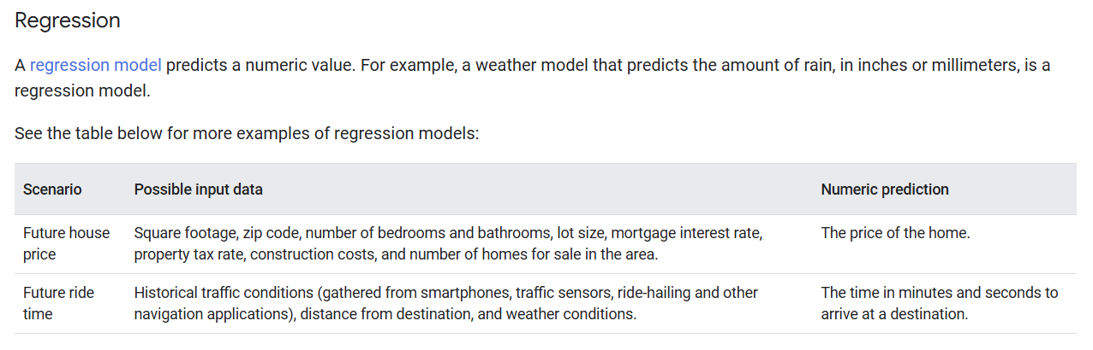

Slide 31
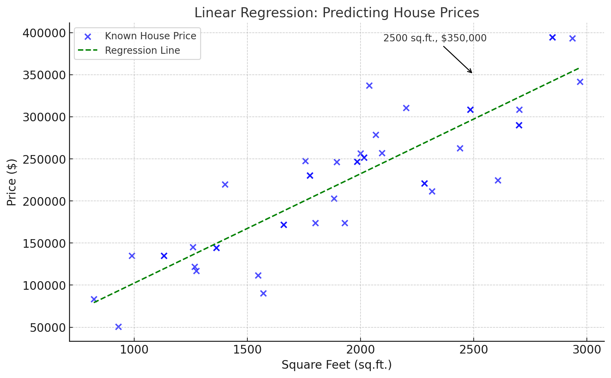
Notes:
https://www.linkedin.com/pulse/predicting-house-prices-using-linear-regression-along-muhammet-ergenc

Slide 32
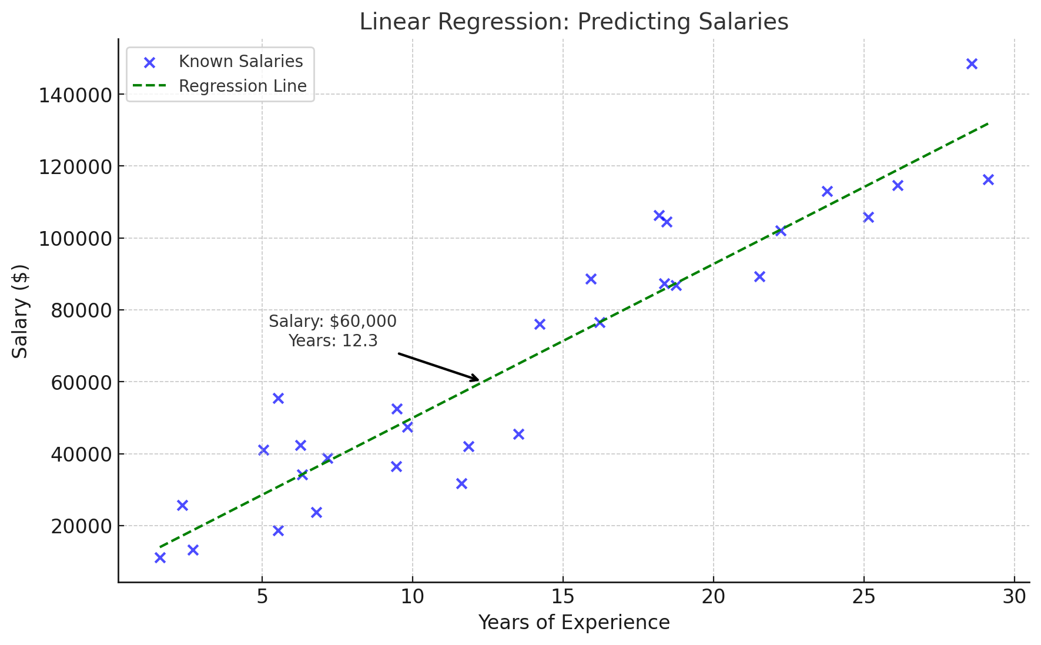
Notes:
https://towardsdatascience.com/machine-learning-simple-linear-regression-with-python-f04ecfdadc13

Slide 33
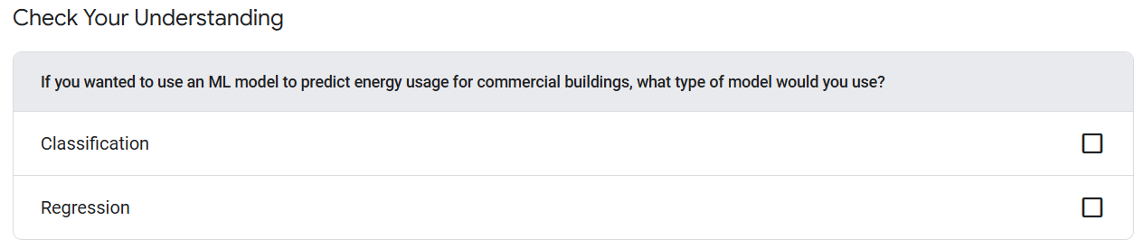

Slide 34
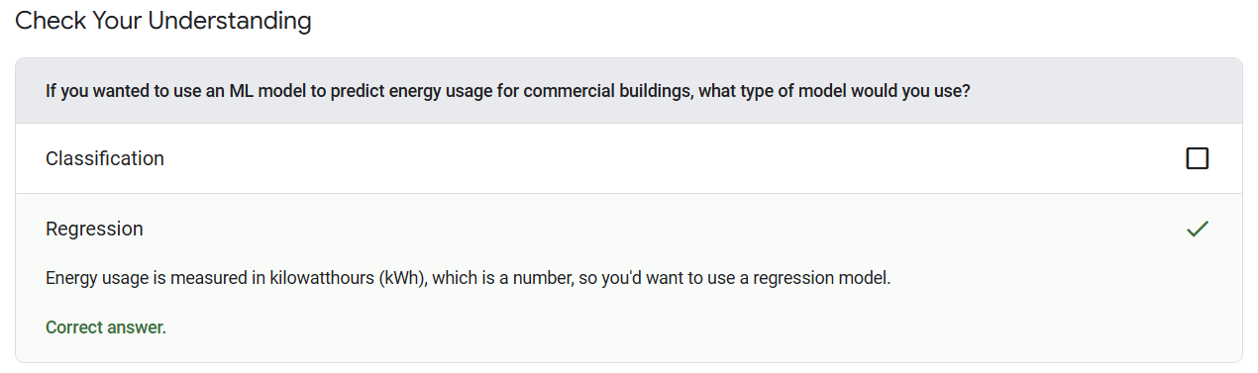

Slide 35
